Slide 1
APPLICATIONS OF REF/RREF
MATH 15 - Linear Algebra

Slide 2
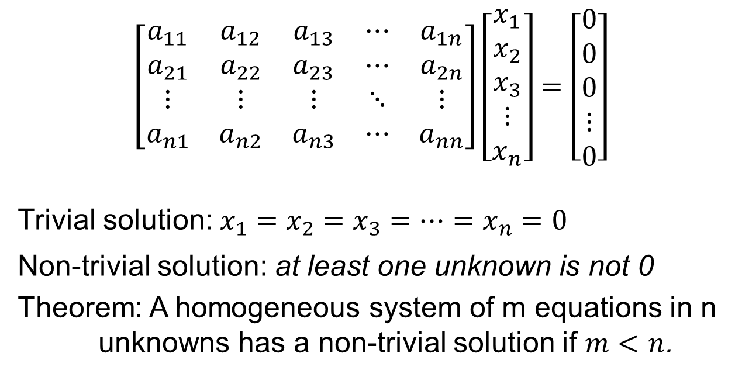
HOMOGENEOUS SYSTEM
$$\left[\begin{matrix}a_{11} & a_{12} & a_{13} & ⋯ & a_{1n} \\ a_{21} & a_{22} & a_{23} & ⋯ & a_{2n} \\ ⋮ & ⋮ & ⋮ & ⋱ & ⋮ \\ a_{n1} & a_{n2} & a_{n3} & ⋯ & a_{nn}\end{matrix}\right]\left[\begin{matrix}x_{1} \\ x_{2} \\ x_{3} \\ ⋮ \\ x_{n}\end{matrix}\right]=\left[\begin{matrix}0 \\ 0 \\ 0 \\ ⋮ \\ 0\end{matrix}\right]$$
Trivial solution: $x_{1}=x_{2}=x_{3}=…=x_{n}=0$
Non-trivial solution: at least one unknown is not 0
Theorem: A homogeneous system of m equations in n
unknowns has a non-trivial solution if $m<n$.

Slide 3
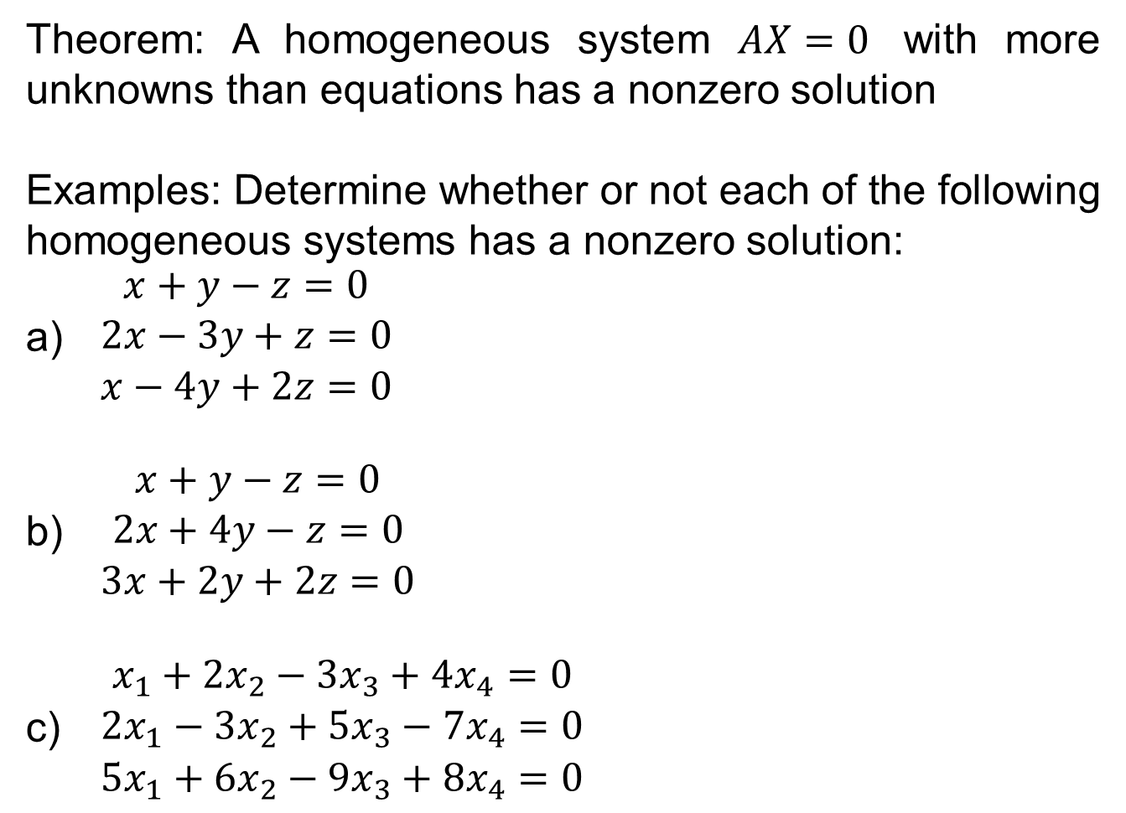
HOMOGENEOUS SYSTEM
Theorem: A homogeneous system $AX=0$ with more unknowns than equations has a nonzero solution
Examples: Determine whether or not each of the following homogeneous systems has a nonzero solution:
$\begin{matrix}x+y−z=0 \\ 2x−3y+z=0 \\ x−4y+2z=0\end{matrix}$
$\begin{matrix}x+y−z=0 \\ 2x+4y−z=0 \\ 3x+2y+2z=0\end{matrix}$
$\begin{matrix}x_{1}+2x_{2}−3x_{3}+4x_{4}=0 \\ 2x_{1}−3x_{2}+5x_{3}−7x_{4}=0 \\ 5x_{1}+6x_{2}−9x_{3}+8x_{4}=0\end{matrix}$
Notes:
Theorem similar with previous slide

Slide 4
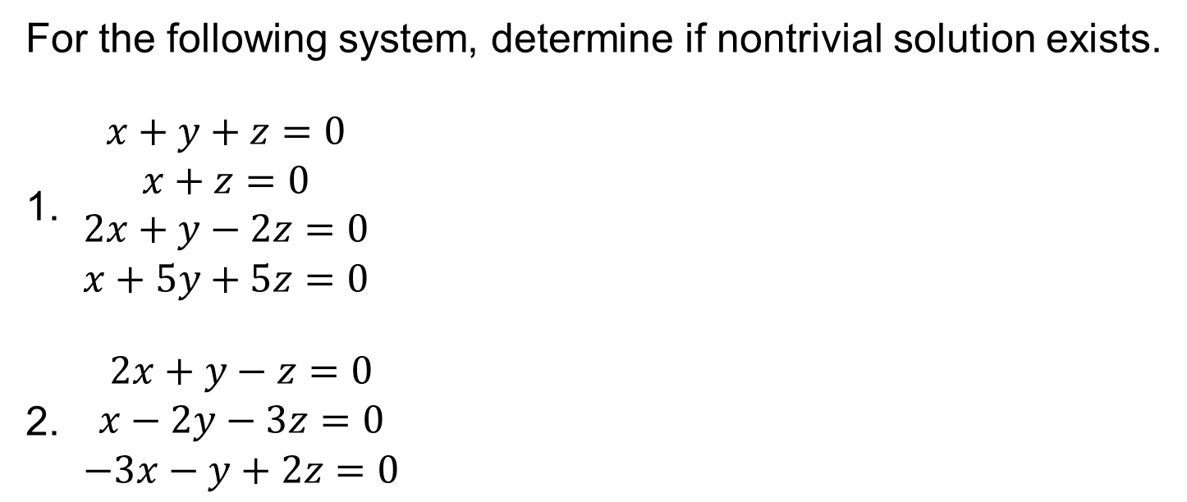
EXAMPLES
For the following system, determine if nontrivial solution exists.
$\begin{matrix}x+y+z=0 \\ x+z=0 \\ 2x+y−2z=0 \\ x+5y+5z=0\end{matrix}$
$\begin{matrix}2x+y−z=0 \\ x−2y−3z=0 \\ −3x−y+2z=0\end{matrix}$

Slide 5
GAUSSIAN ELIMINATION
Augmented Matrix. Write the augmented matrix of the system.
A matrix that includes the entire linear system is called an augmented matrix.
A matrix that is made up only of the coefficients that multiply the unknown variables is known as coefficient matrix.
Row-Echelon Form. Use elementary row operations to change the augmented matrix of to row-echelon form.
Back-Substitution. Write the new system of equations that corresponds to the row-echelon form of the augmented matrix and solve by back-substitution.

Slide 6
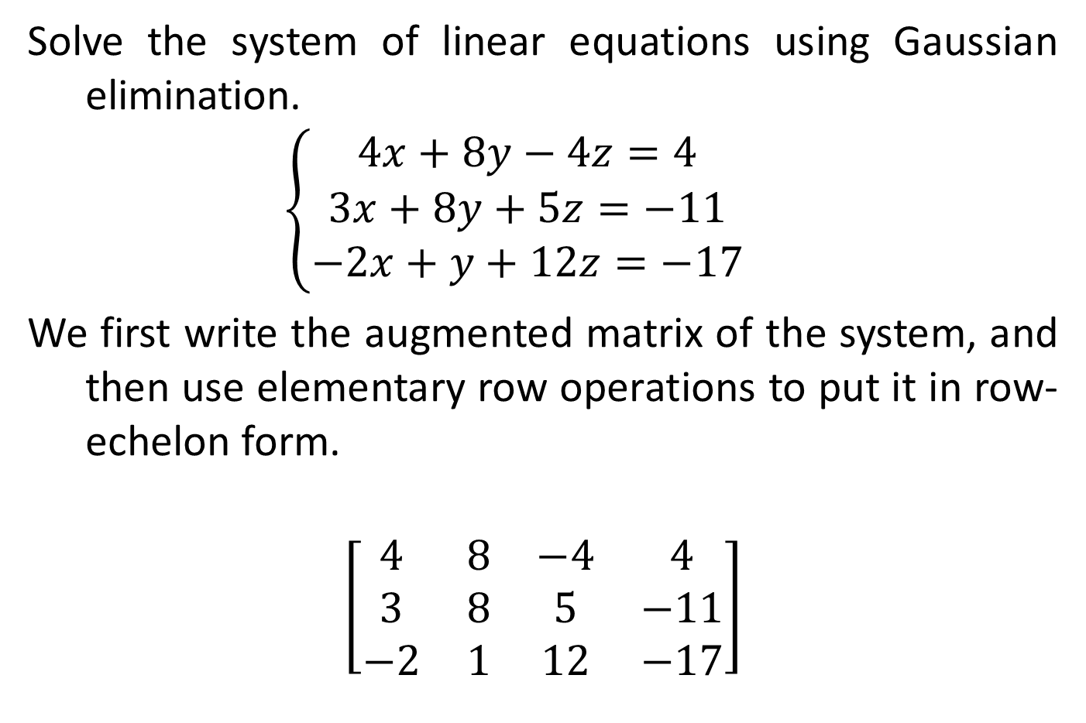
GAUSSIAN ELIMINATION EXAMPLE
Solve the system of linear equations using Gaussian elimination.
$$\left\{\begin{matrix}4x+8y−4z=4 \\ 3x+8y+5z=−11 \\ −2x+y+12z=−17\end{matrix}\right.$$
We first write the augmented matrix of the system, and then use elementary row operations to put it in row-echelon form.
$$\left[\begin{matrix}4 & 8 & −4 & 4 \\ 3 & 8 & 5 & −11 \\ −2 & 1 & 12 & −17\end{matrix}\right]$$
Notes:
Complete the solution on board.

Slide 7
GAUSS-JORDAN ELIMINATION
If we put the augmented matrix of a linear system in reduced row-echelon form, then we don’t need to back-substitute to solve the system. To put a matrix in reduced row-echelon form, we use the following steps.
Use the elementary row operations to put the matrix in row-echelon form.
Obtain zeros above each leading entry by adding multiples of the row containing that entry to the rows above it. Begin with the last entry and work up.

Slide 8
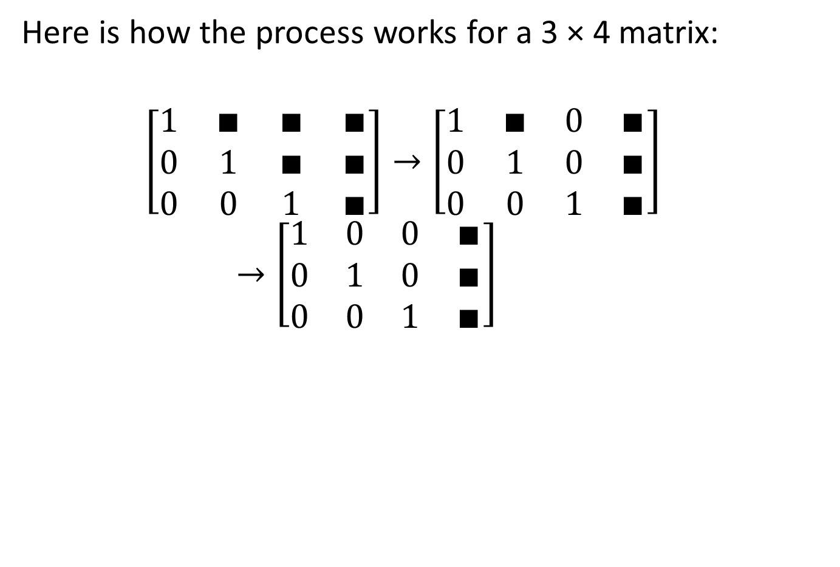
GAUSS-JORDAN ELIMINATION
Here is how the process works for a 3 × 4 matrix:
$$\left[\begin{matrix}1 & ∎ & ∎ & ∎ \\ 0 & 1 & ∎ & ∎ \\ 0 & 0 & 1 & ∎\end{matrix}\right]→\left[\begin{matrix}1 & ∎ & 0 & ∎ \\ 0 & 1 & 0 & ∎ \\ 0 & 0 & 1 & ∎\end{matrix}\right]→\left[\begin{matrix}1 & 0 & 0 & ∎ \\ 0 & 1 & 0 & ∎ \\ 0 & 0 & 1 & ∎\end{matrix}\right]$$

Slide 9
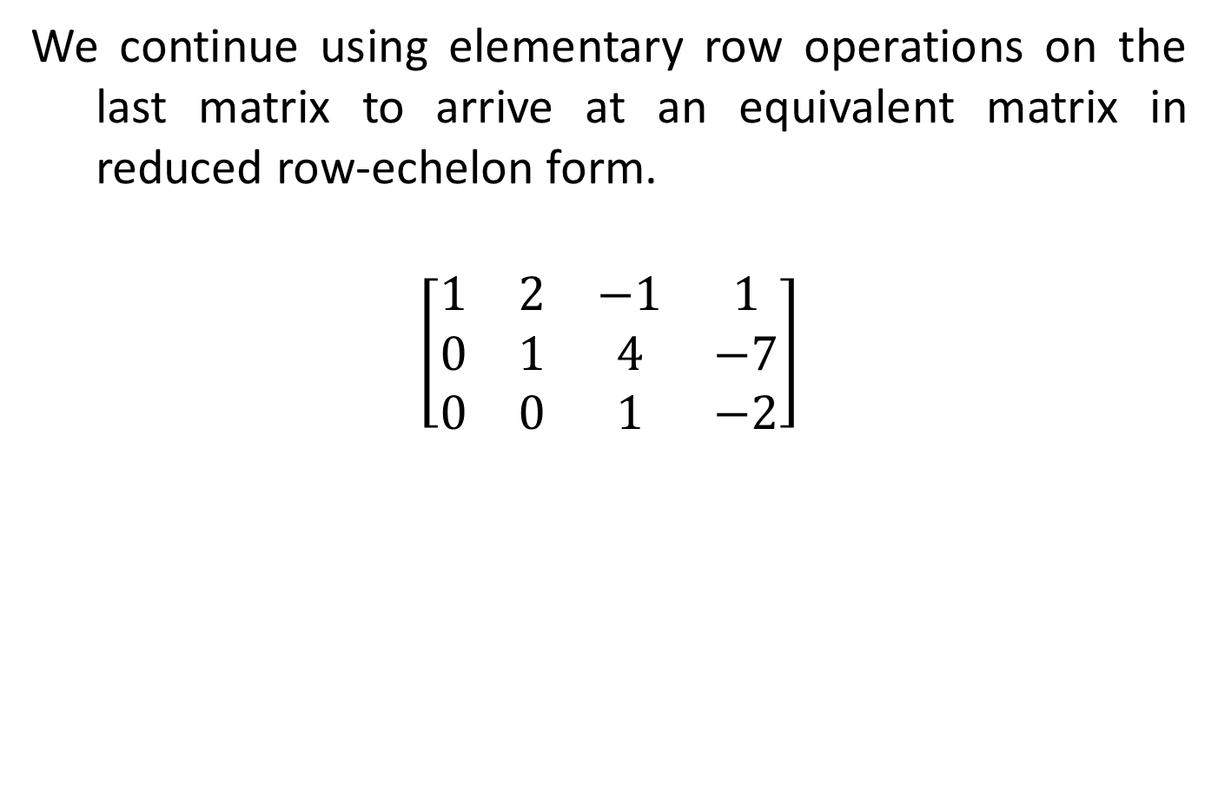
GAUSS-JORDAN ELIMINATION EXAMPLE
We continue using elementary row operations on the last matrix to arrive at an equivalent matrix in reduced row-echelon form.
$$\left[\begin{matrix}1 & 2 & −1 & 1 \\ 0 & 1 & 4 & −7 \\ 0 & 0 & 1 & −2\end{matrix}\right]$$
Notes:
Complete the solution on board.
Answer: (-3, 1, -2)

Slide 10
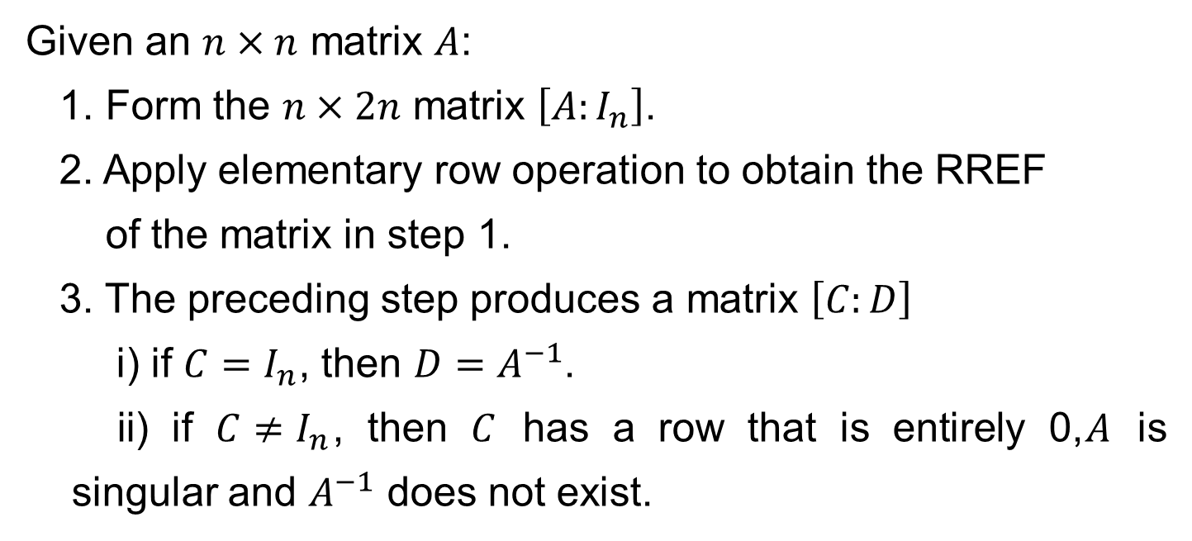
MATRIX INVERSION
Given an $n×n$ matrix $A$:
1. Form the $n×2n$ matrix $\left[A:I_{n}\right]$.
2. Apply elementary row operation to obtain the RREF
of the matrix in step 1.
3. The preceding step produces a matrix $\left[C:D\right]$
i) if $C=I_{n}$, then $D=A^{−1}$.
ii) if $C≠I_{n}$, then $C$ has a row that is entirely 0,$A$ is singular and $A^{−1}$ does not exist.

Slide 11
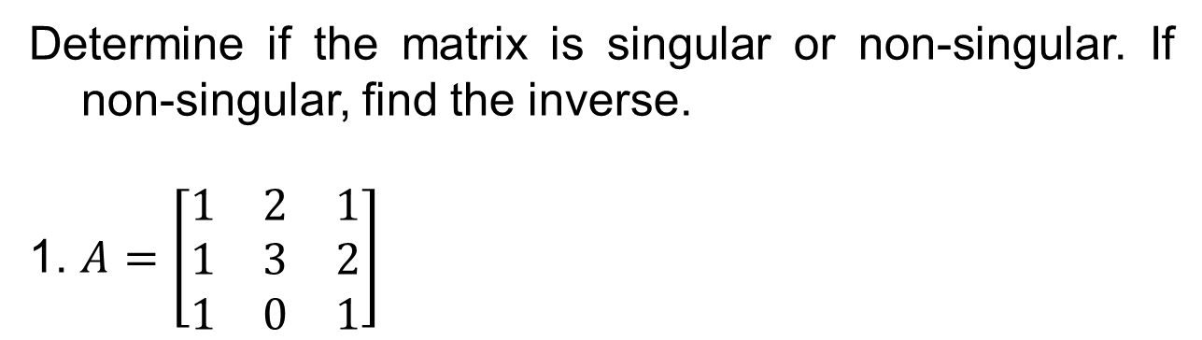
EXAMPLE
Determine if the matrix is singular or non-singular. If non-singular, find the inverse.
1. $A=\left[\begin{matrix}1 & 2 & 1 \\ 1 & 3 & 2 \\ 1 & 0 & 1\end{matrix}\right]$

Slide 12
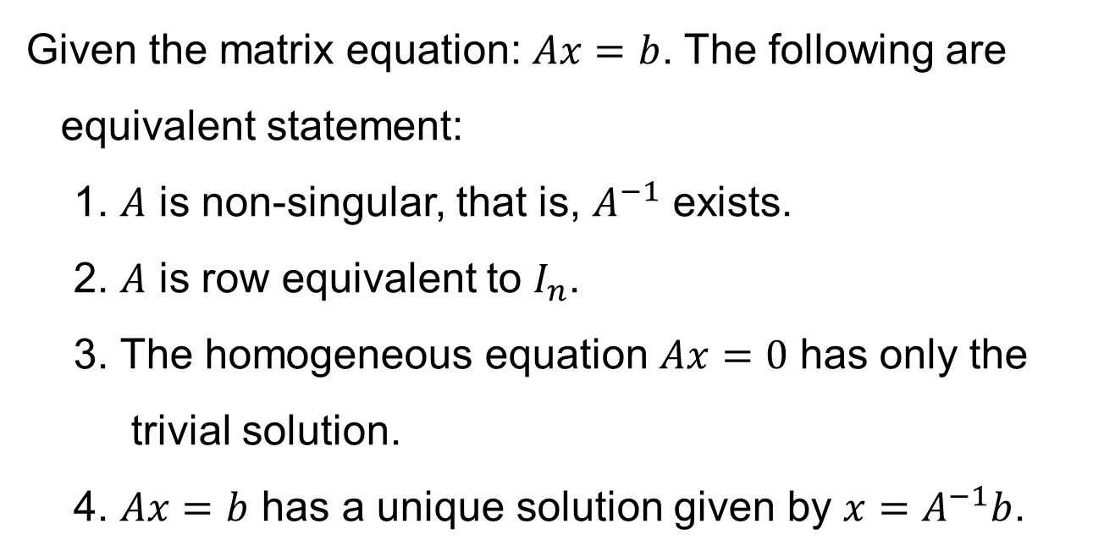
SOLUTION BY MATRIX INVERSION
Given the matrix equation: $Ax=b$. The following are
equivalent statement:
1. $A$ is non-singular, that is, $A^{−1}$ exists.
2. $A$ is row equivalent to $I_{n}$.
3. The homogeneous equation $Ax=0$ has only the
trivial solution.
4. $Ax=b$ has a unique solution given by $x=A^{−1}b$.

Slide 13
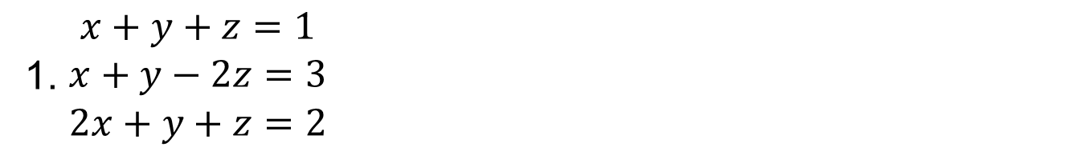
Seatwork: Solve by matrix inversion
EXAMPLE
1. $\begin{matrix}x+y+z=1 \\ x+y−2z=3 \\ 2x+y+z=2\end{matrix}$

